Slide 1
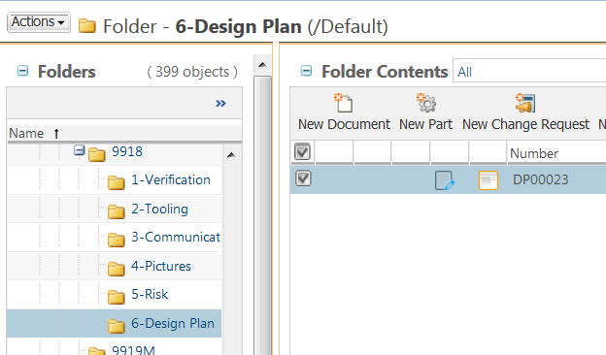

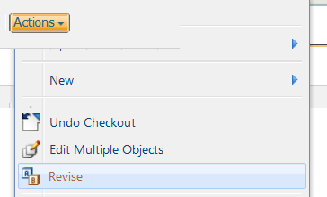
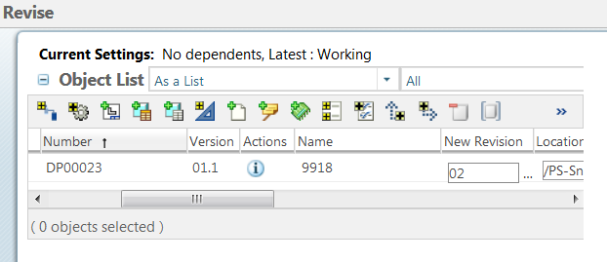


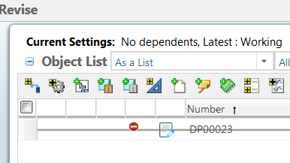
How to Revise in Windchill
a. From any Windchill tables. Select What need to be revised by checking the check box.
1 Select
a
NOTE: - you can select any documents or CADs.
b. Click Actions.
c. Select Revise
b
2 Revise
c
In the move dialog:
d. Validate the form.
e. Click OK
CAUTION: Read the instructions in sequence. Actions in point 2 should not be done before completing point 1.
3 Validate form
Tool Tips
Instead of using the move function you can use the Cut function.
NOTE: If Windchill refuse to allow you to revise. Validate the status of the document. Some documents have restrictions depending on their status.

